Slide 1
Image Captioning
Ashraf Adel 196280
Farah Aymen 194233
Jacinta Samir 206562
Mohamed Negm 206069

Slide 2
TABLE OF CONTENTS
01
02
Introduction & PreProcessing
ChatGPT
03
04
Comparative Analysis
Conclusion
What is Image Captioning?
Analyzing ChatGPT output
Analyzing and comparing between word embeddings: CBOW, Skipgram
What’s next?

Slide 3
INTRODUCTION
Image captioning is a task of generating natural language descriptions of the content of an image. It has been an active research topic in the field of computer vision and natural language processing for several years. In this literature review, we will discuss some of the significant contributions made to image captioning and explore the current state-of-the-art models.

Slide 4
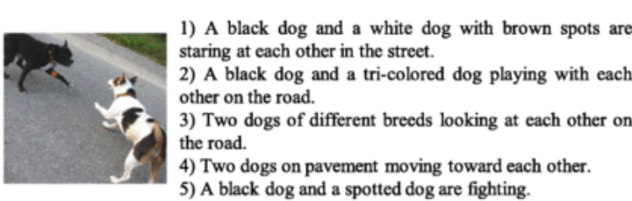
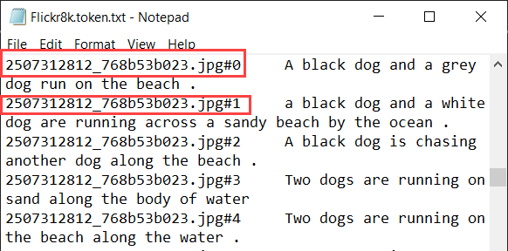
Pre-Processing
caption's structure:

Slide 5
Pre-Processing
imgToCaptions dictionary
basic stopwords removed
no stemming; should be coherent English
8k images * 5 captions * 7 words ≈ 280k words
vocab of words
function to limit words by frequency threshold
full vocab ≈ 8k words
>= 5 occurring words ≈ 3k words
wordToIdx dictionary
prefix, suffix words to each caption
Google’s InceptionV3 for image feature vector
Overview of Pipeline:
Side Note:
= For Phase 2

Slide 6

ChatGPT
ChatGPT
ChatGPT, have grown in popularity and applicability as of late. With this comes the need to construct effective prompts, to be able to exploit these models and extract outputs as appropriate and prosperous as possible. ChatGPT will be prompted to write a literature review on image captioning. It is expected to sufficiently demonstrate the previous work and state-of-the-art in the subject

Slide 7
ChatGPT ANALYSIS
1
Write Literature Review
2
Pretend to be an expert and write a Literature review
ChatGPT was able to produce a modest literature review, structured decently. The literature review lacked in thorough comparison between the models, stating only vaguely how some outperformed others
ChatGPT seems to mostly summarize the papers well, although lacking more concrete descriptions of the architectures implemented.

Slide 8
ChatGPT ANALYSIS
Prompt | Content Relevance | Quality | Reliability | Fulfillment of Requirements | Score (/20)
Simple | 4 | 3 | 2 | 3 | 12
Detailed | 5 | 4 | 3 | 4 | 16

Slide 9
COMPARITIVE ANALYSIS
SkipGram
CBOW
Each word is represented as a high-dimensional Then, a neural network is used in the to predict the likelihood of occurrence of context words given a target word
Epoch 5000: Loss = 5.52083
It is used to predict a target word given its context words. The context words are represented as a bag of words and are combined to generate a dense vector representation for the target word.
Epoch 1000: Loss = 82.9637

Slide 10
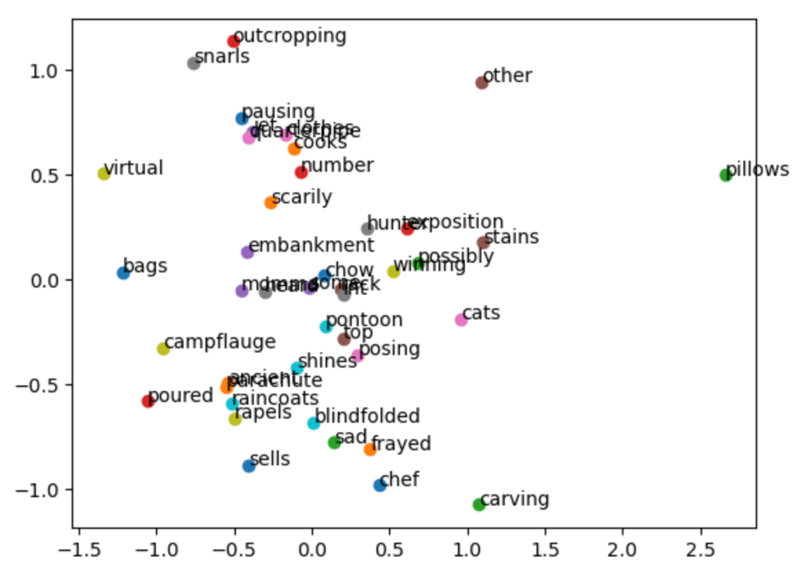
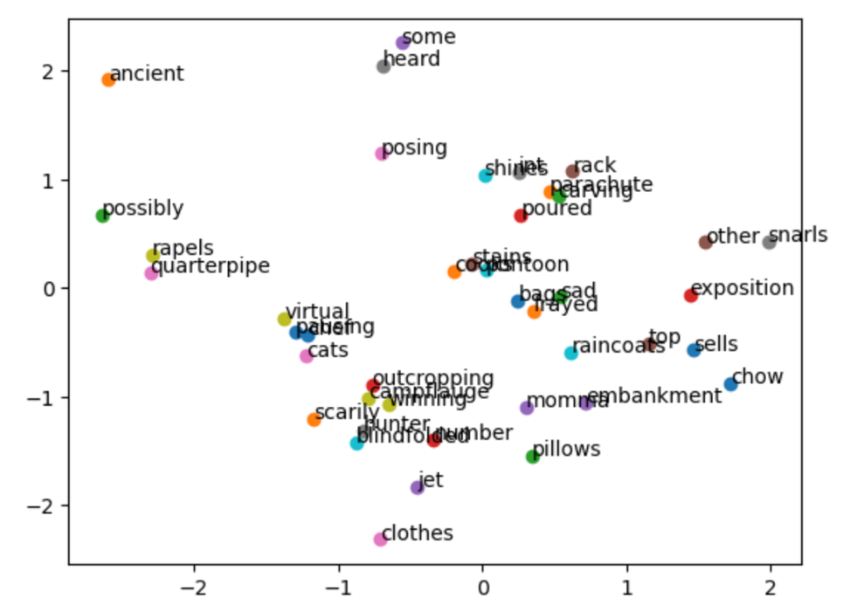
COMPARITIVE ANALYSIS: Applying PCA
SkipGram
CBOW

Slide 11
Conclusion
ChatGPT has generated promising outputs but cannot competently replace human work, and should be an assistive tool. Regarding the word embeddings, although Skip-gram outperformed CBOW, its results were still not satisfactory. Thus, we will also be utilizing GloVe in Phase II

Slide 12
THANKS

